Slide 1
Machine Learning AIML CLZG565
M3 : Linear Models for Regression
Dr. Sugata Ghosal
sugata.ghosal@pilani.bits-pilani.ac.in

Slide 2
Linear Regression

Slide 3
Linear Basis Models

Slide 4
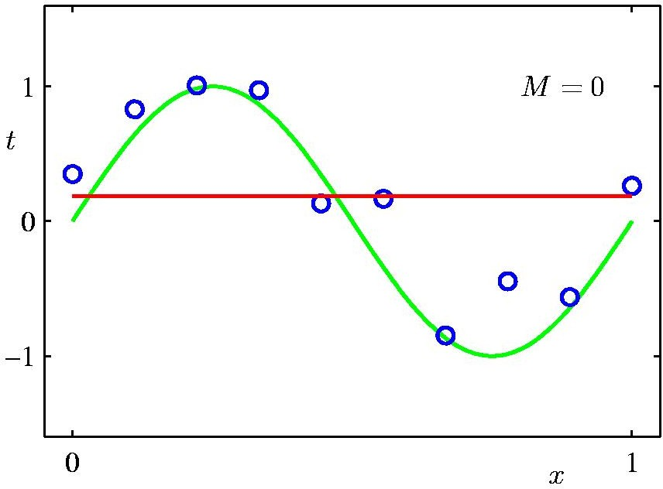
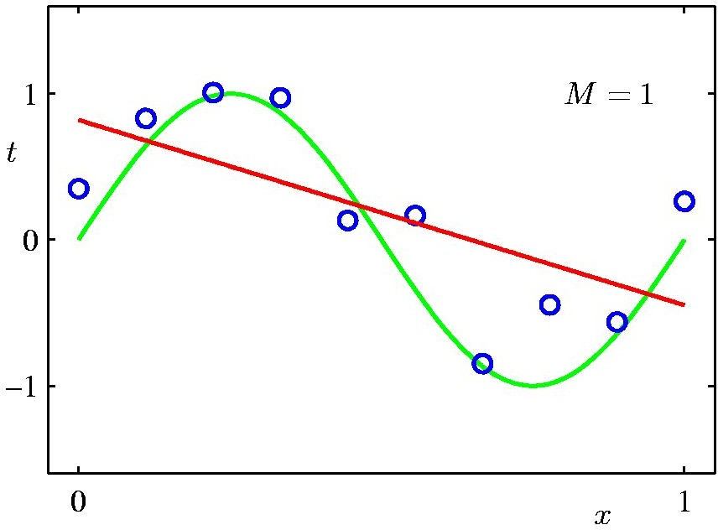
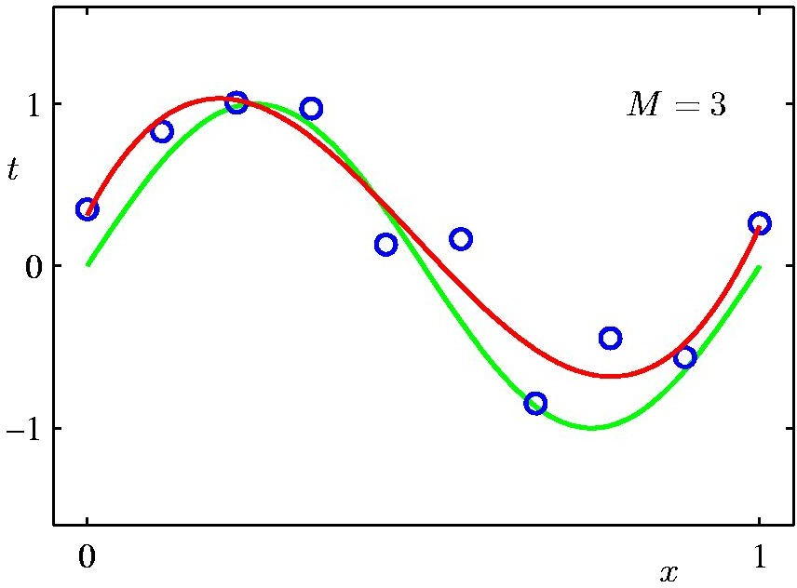
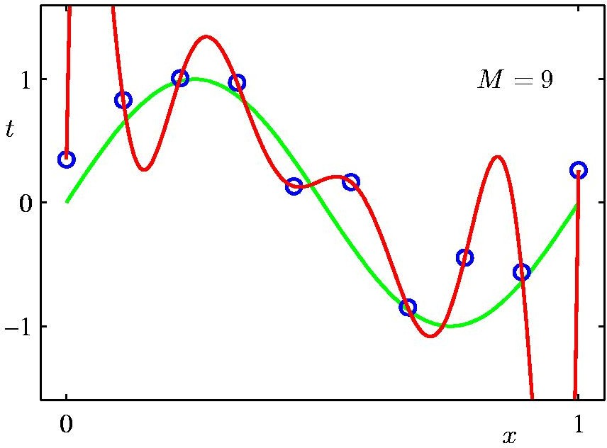
Polynomial Regression
17 / 22

Slide 5
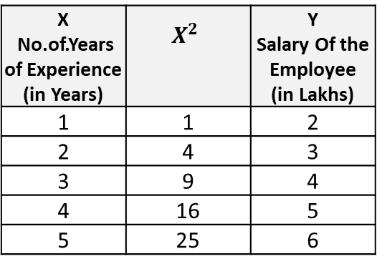
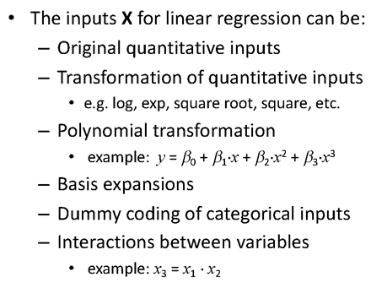
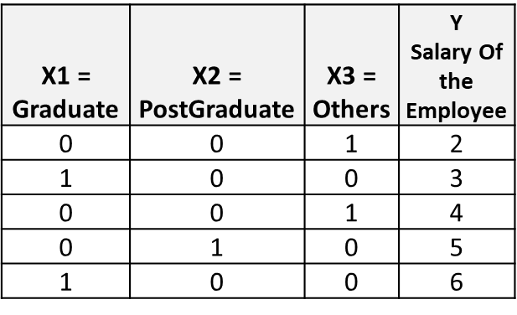

Linear Basis Function Models

Slide 6
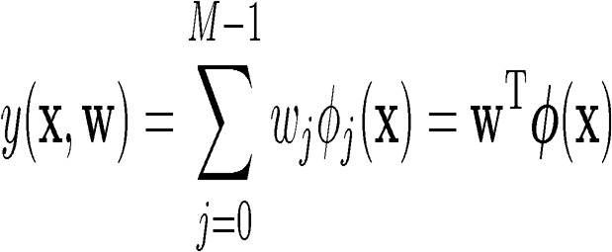
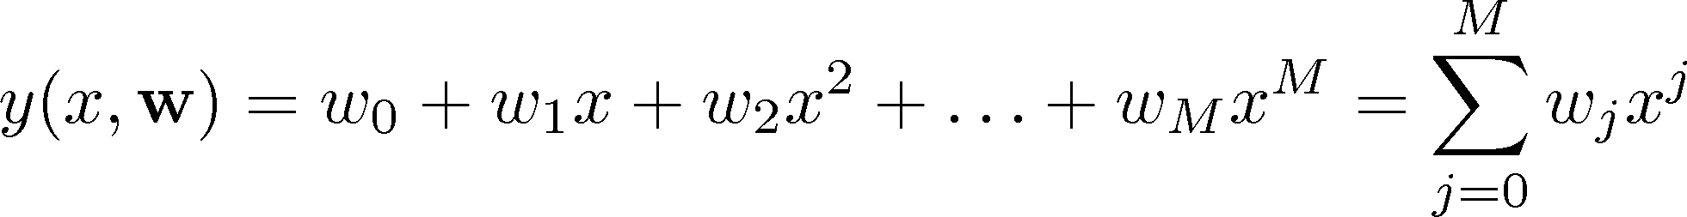
Linear Basis Function Models
Example: an M-th order polynomial function of one dimensional feature x :
where x^{j} = j-th power of x
Φ_{j}(x) are known as basis functions. Typically, Φ₀(x) = 1, so that w₀ acts as a bias.
In the simplest case, we use linear basis functions : Φ_{d}(x) = x_{d}.
They are called linear models because this function is linear in w.

Slide 7
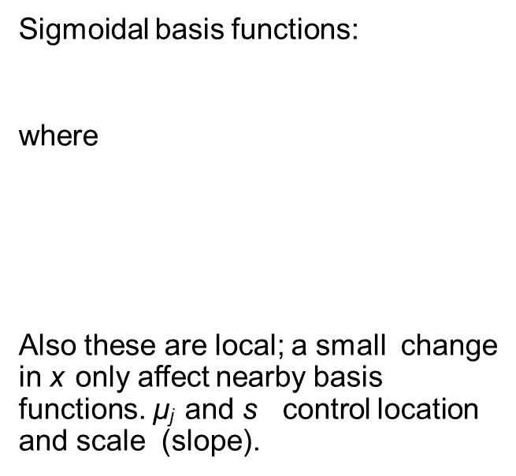
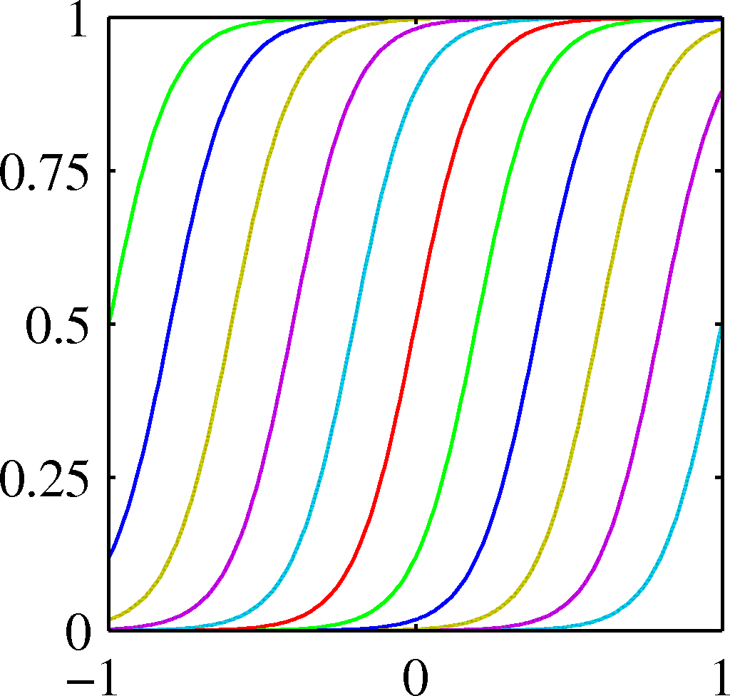
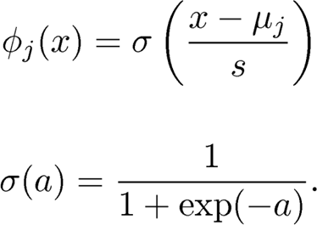
Linear Basis Function Models - Examples

Slide 8
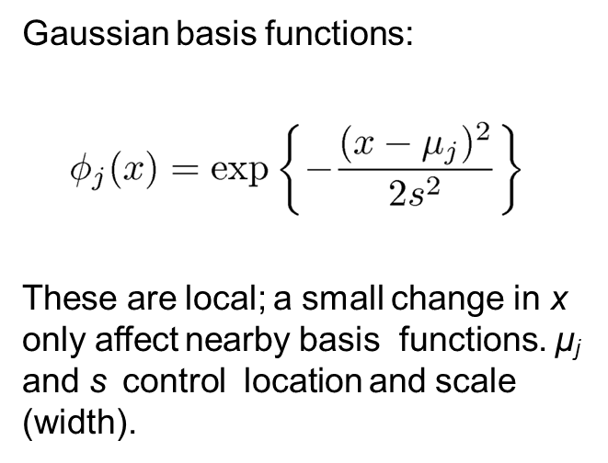
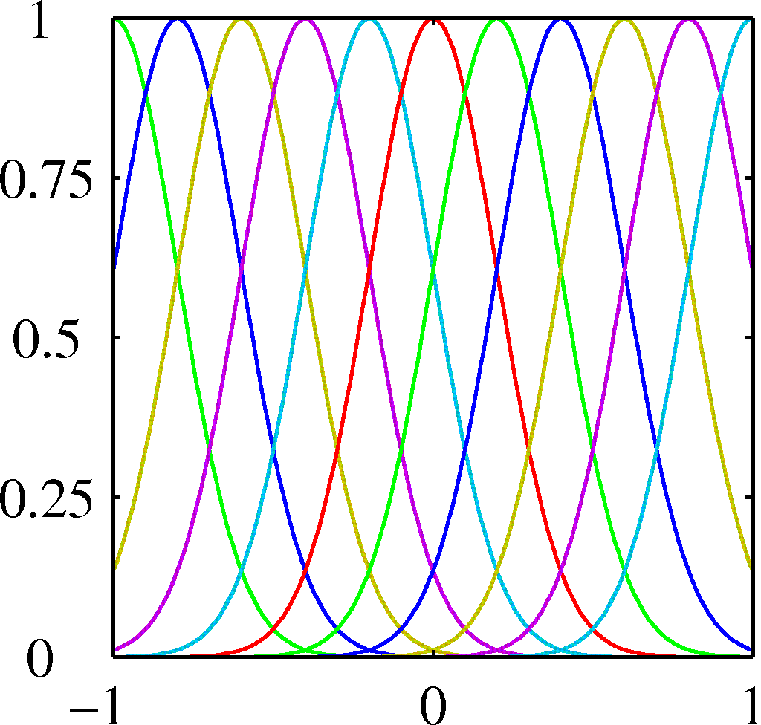
Linear Basis Function Models - Examples

Slide 9
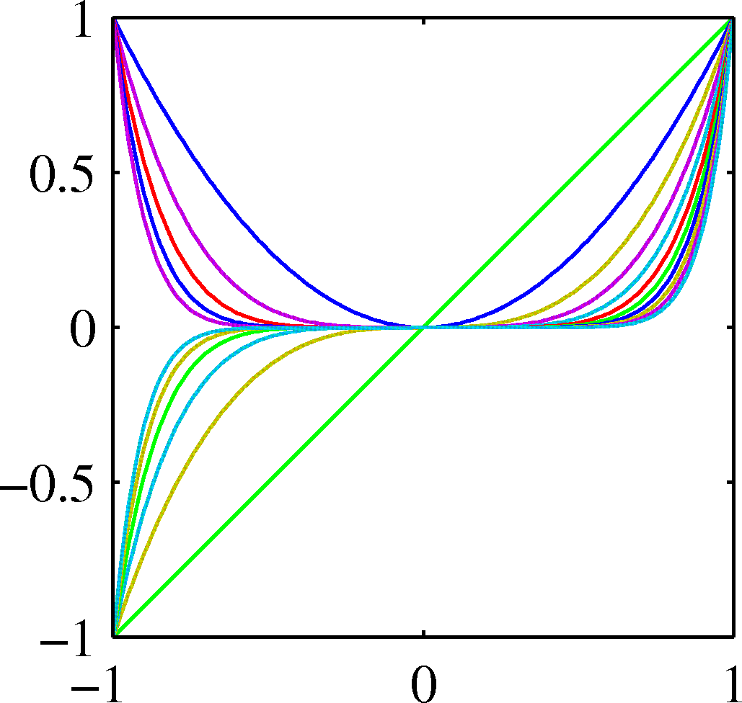
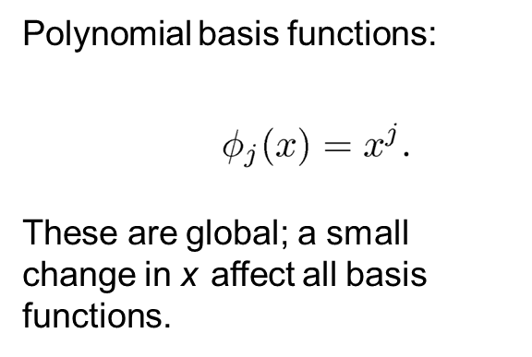
Linear Basis Function Models - Examples

Slide 10
Notion of Bias - Variance

Slide 11
Addressing overfitting
$x_{1}=$ size of house
$x_{2}=$ no. of bedrooms
$x_{3}=$ no. of floors
$x_{4}=$age of house
$x_{5}=$average income in neighborhood
$x_{6}=$ kitchen size
$⋮$
$x_{100}$
Price ($) in 1000’s
Size in feet^2

Slide 12
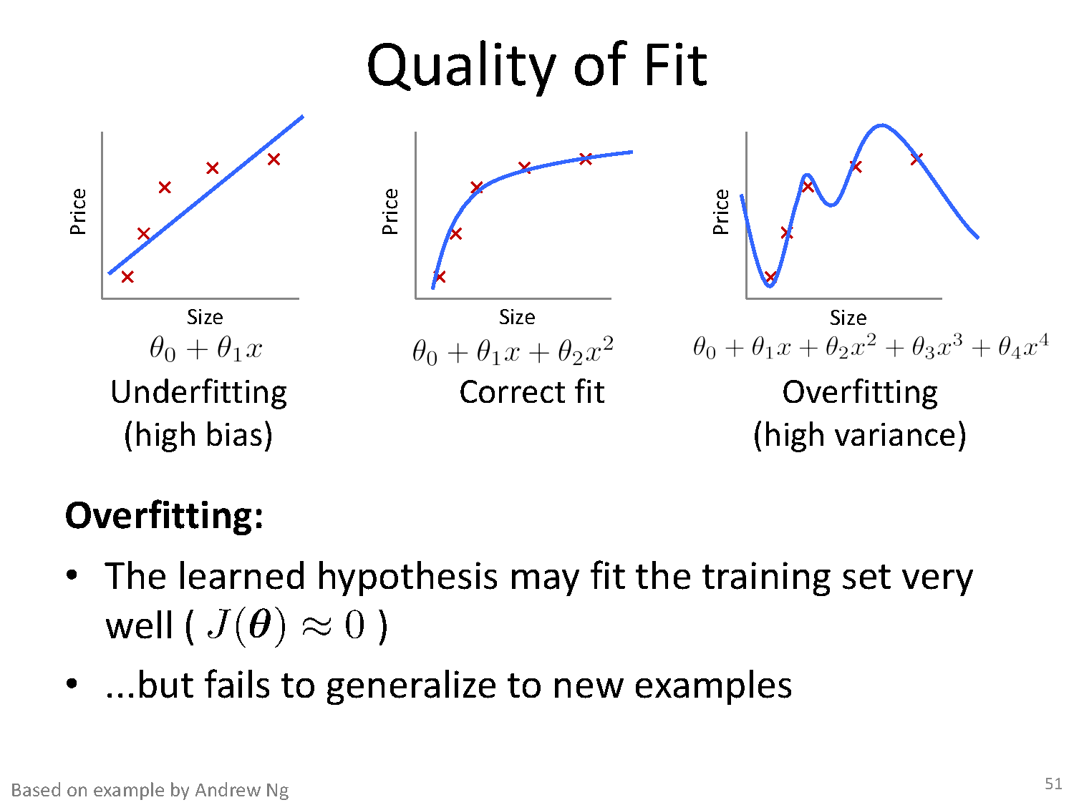
Quality of Fit

Slide 13
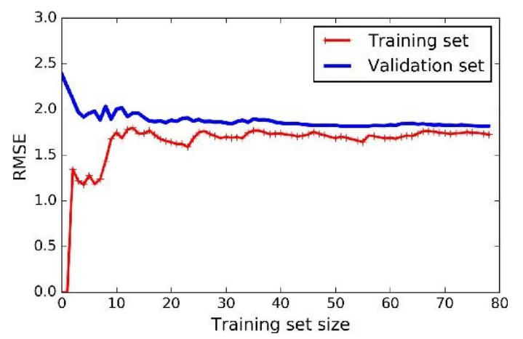
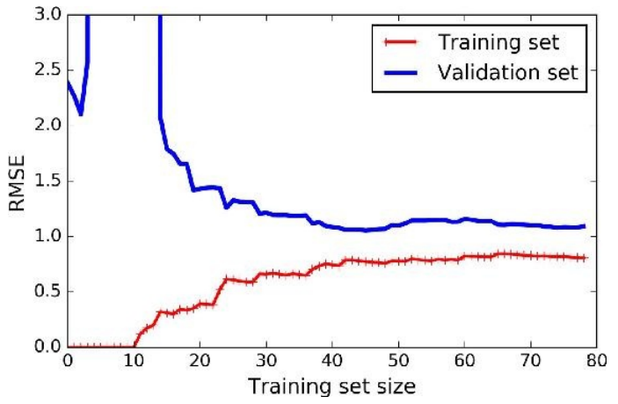
Effect of Training Size on Over fitting
Size of training dataset needs to be large to prevent when higher order model is used.
Higher order model
Lower order model

Slide 14
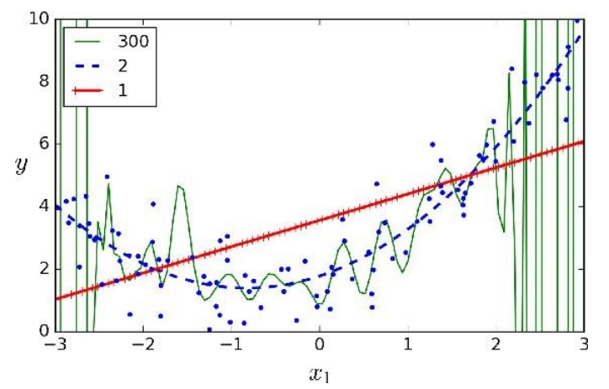
Polynomial Fitting can lead to Over fitting
Underlying target function is quadratic
Linear model results in under fitting with large bias
Polynomial of order 300 results in a large variance

Slide 15
Regularization

Slide 16
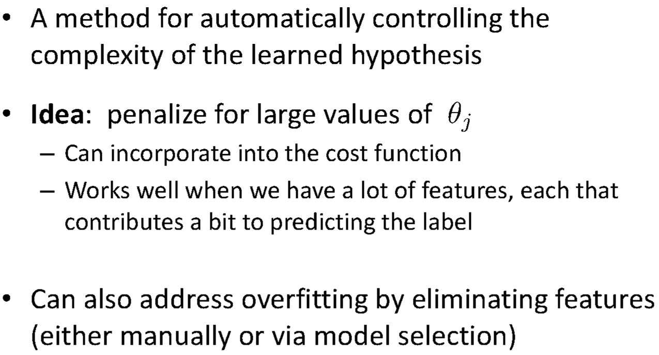
Regularization

Slide 17
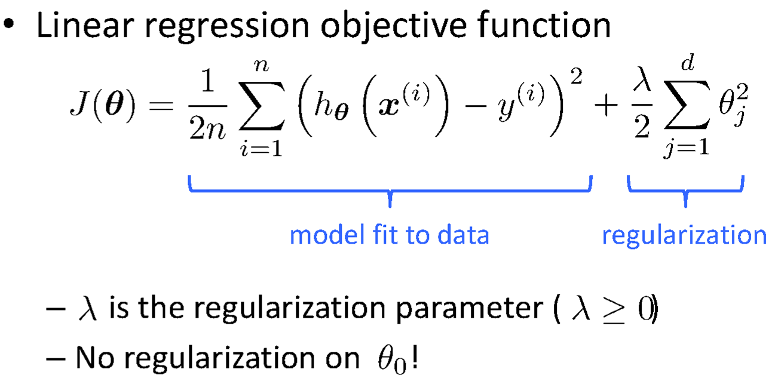
Regularization

Slide 18
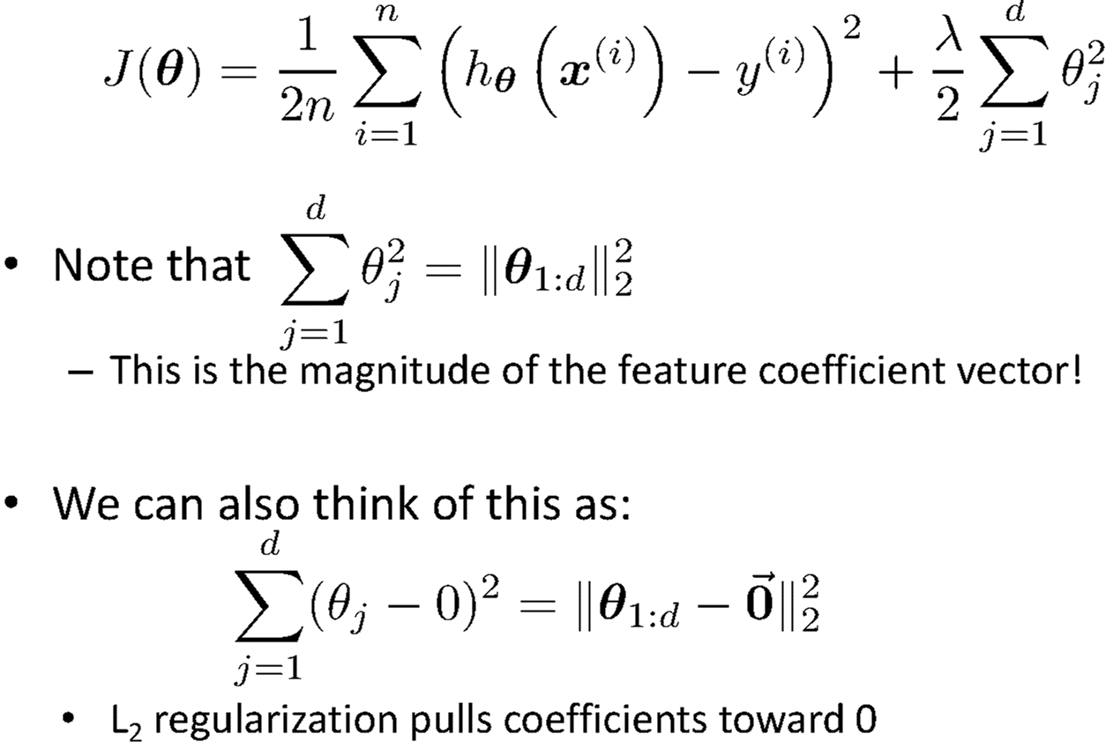
Understanding Regularization

Slide 19
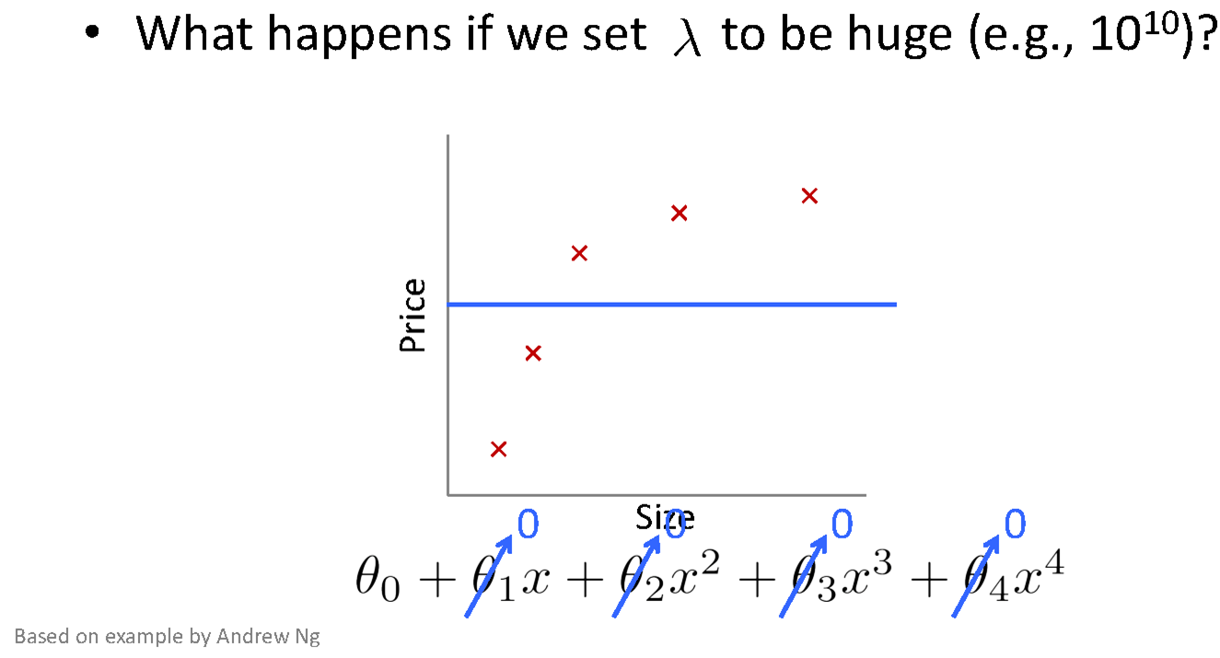
Understanding Regularization

Slide 20
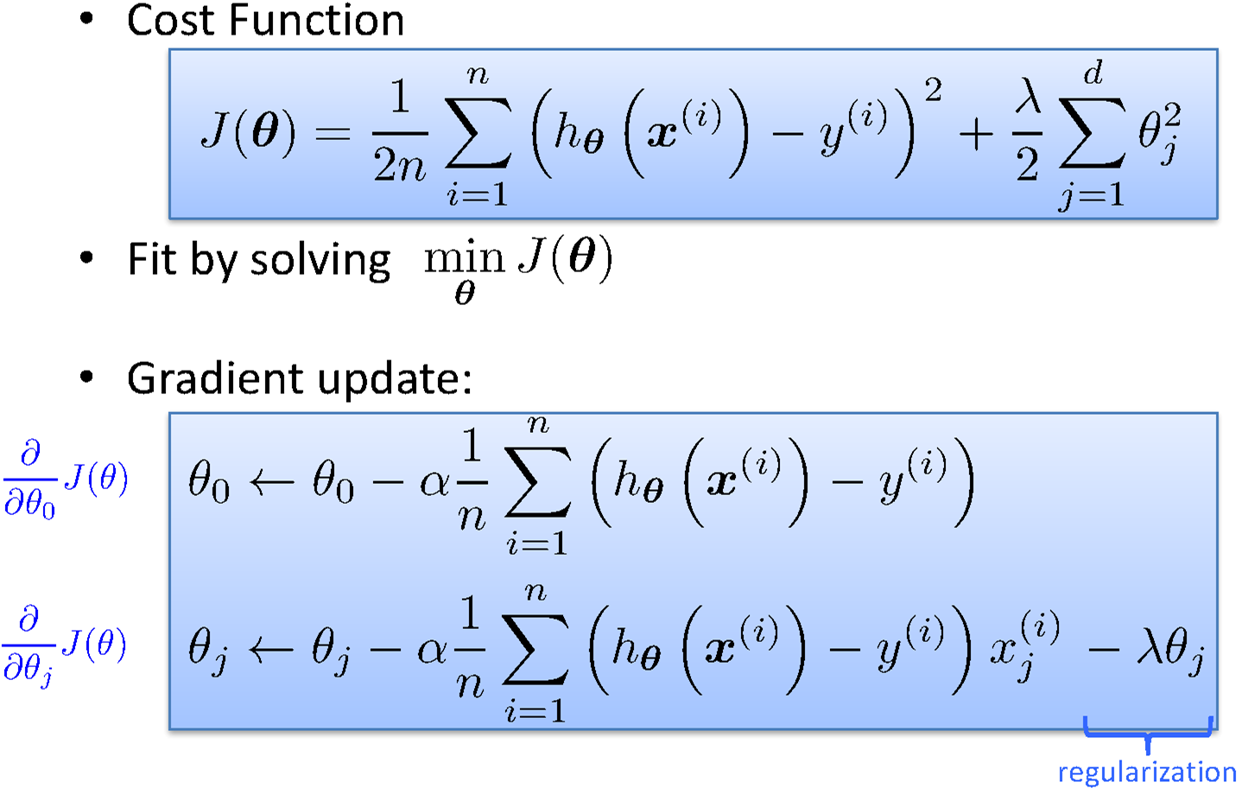
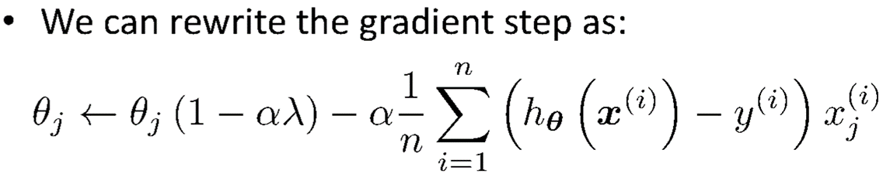
Regularized Linear Regression

Slide 21
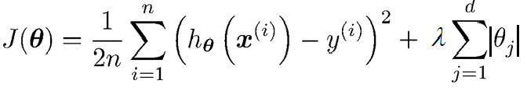
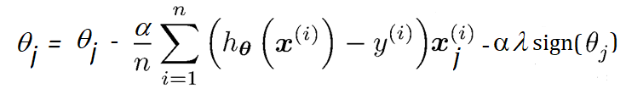
Lasso Regularization

Slide 22
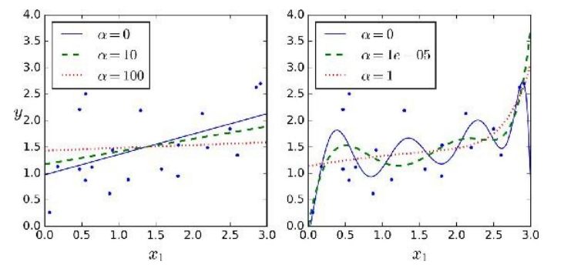
Ridge Vs Lasso Regularization
λ = 0
λ = 0
λ = 10
λ = 10⁻⁵
λ = 100
λ = 1
Ridge

Slide 23
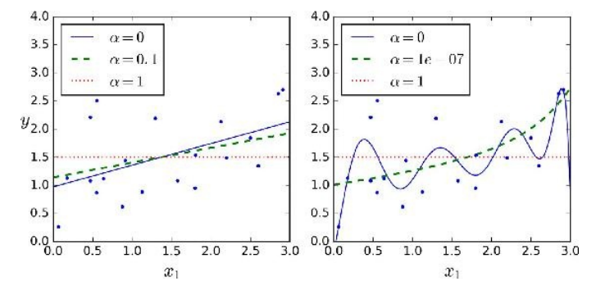
Ridge Vs Lasso Regularization
λ = 0
λ = 0
λ = 0.1
λ = 10⁻⁷
λ = 1
λ = 1
λ
Lasso

Slide 24
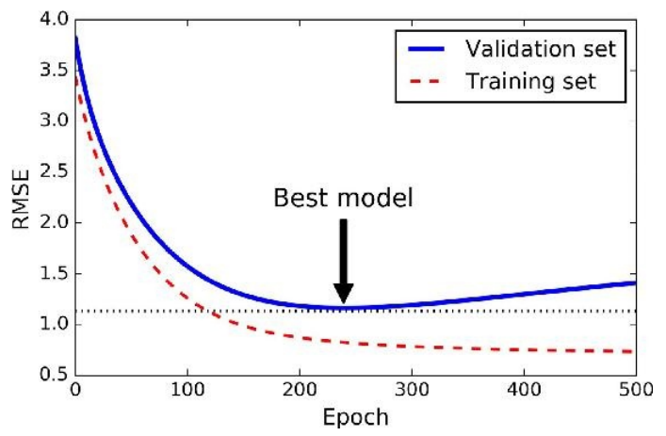
Early Stopping
Do Not Over train to prevent overfitting
Stop training once error on the validation set starts showing an upward trend, even if the error on the training set keeps decreasing

Slide 25
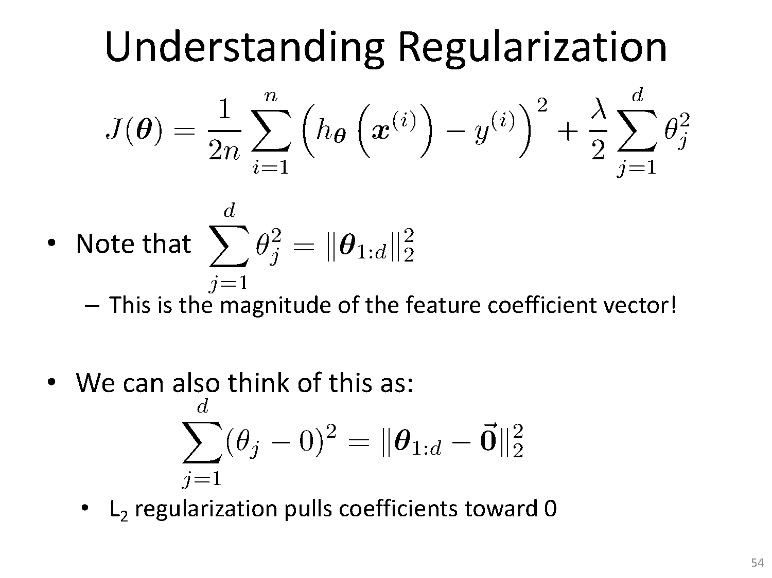

Slide 27
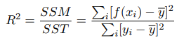
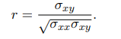
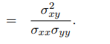
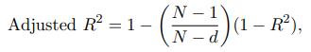
How Good is the Fit ?
Coefficient of Determination
R² is related to correlation coefficient
R²

Slide 28
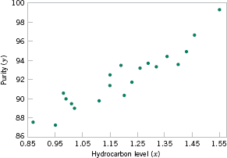
Simple linear regression
Based on the scatter diagram, it is probably reasonable to assume that the mean of the random variable Y is related to X by the following simple linear regression model:
Response
Regressor or Predictor
Y_{i} = β₀ + β₁ X_{i} + ε_{i}
i = 1,2,!, n
ε _{i}
Intercept Slope
Random error
ε_{ι} ∼ Ν (0, σ² )
where the slope and intercept of the line are called regression coefficients.
The case of simple linear regression considers a single regressor or predictor x and a dependent or response variable Y.

Slide 29
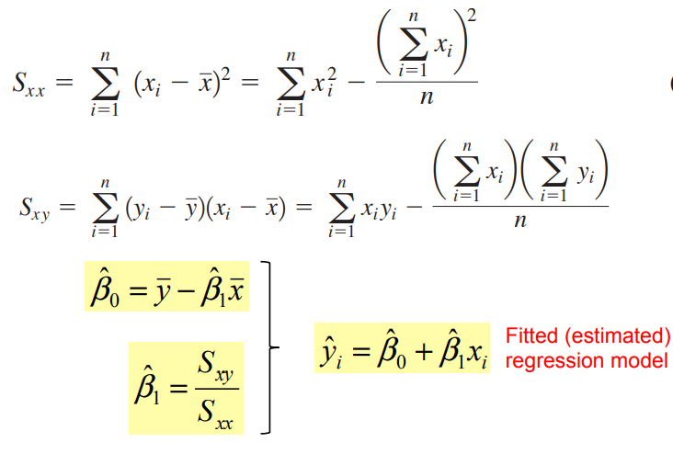
Regression coefficients
Caveat: regression relationship are valid only for values of the regressor variable within the range the original data. Be careful with extrapolation.

Slide 30
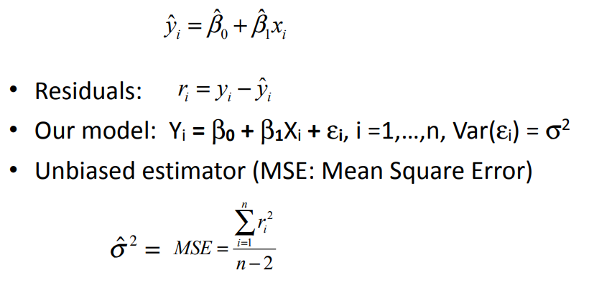
Estimation of variance
Using the fitted model, we can estimate value of the response variable for given predictor

Slide 31
Key Point
the coefficients
_{β}ˆ
and β^{ˆ}
1 0
are both calculated from data, and they are subject to error.
if the true model is y = β₁ x + β₀ , β^{ˆ} and β^{ˆ} are
1 0
point estimators for the true coefficients
we can talk about the ``accuracy’’ of β^{ˆ}
and β^{ˆ}
1
0

Slide 32
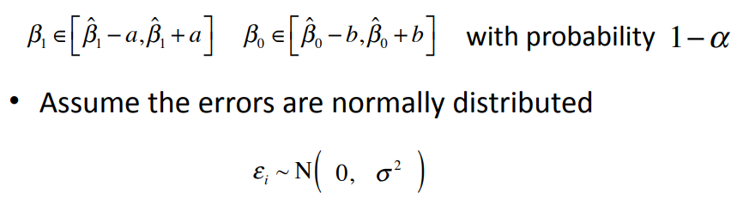
Assessing linear regression model
Test hypothesis about true slope and intercept
β₁ = ?, β₀ = ?
Construct confidence intervals

Slide 33
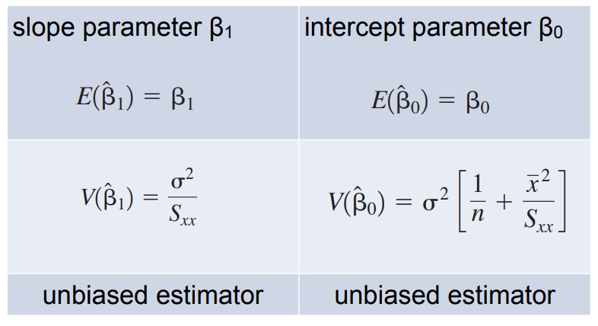
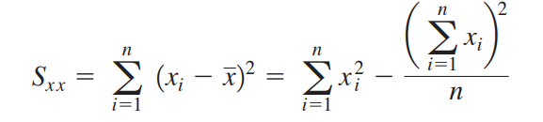
Properties of Regression Estimators

Slide 34
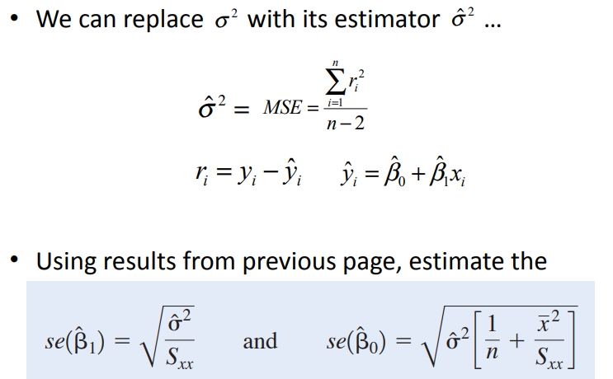
Standard errors of coefficients

Slide 35

Hypothesis test in simple linear regression
we wish to test the hypothesis whether the slope equals a constant β1,0
H₀: β₁ = β _{1,0}
H₁: β != β_{1,0}
e.g. relate ads to sales, we are interested in study whether or not increase a $ on ads will increase $ β1,0 in sales?
sale = β1,0 ads + constant?

Slide 36

A related and important question…
whether or not the slope is zero ?
H₀: β₁ = 0
H₁: β₁ != 0
if β1 = 0, that means Y does not depend on X, i.e.,
Y and X are independent
In the advertisement example does ads increase sales? or no effect?
Significance of regression
,

Slide 37
y
y
(a)
H0 not rejected
x
(b)
H0 rejected
x

Slide 38
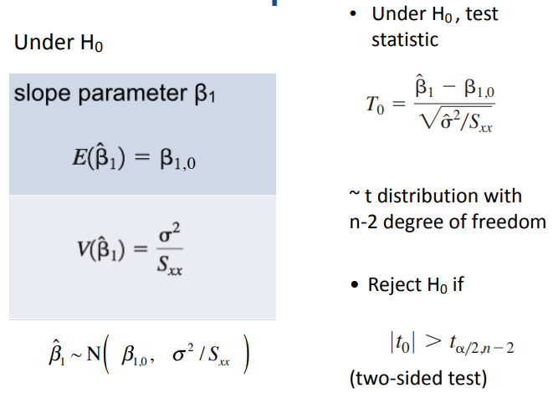
Use t-test for slope

Slide 39
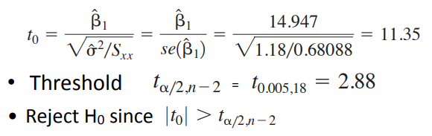
Example: oxygen purity tests of coefficients
Consider the test
H₀: β₁ = 0
H₁: β₁ != 0
100
98
96
β^{ˆ} ₁ = 14.947
S_{xx} = 0.68088,
n = 20,
σˆ ² = 1.18
Purity ( y)
94
92
90
88
Calculate the test statistic
86
0.85 0.95 1.05 1.15 1.25 1.35 1.45 1.55
Hydrocarbon level ( x)
Scatter diagram of oxygen purity versus hydrocarbon
Figure 11-1
level from Table 11-1.

Slide 40
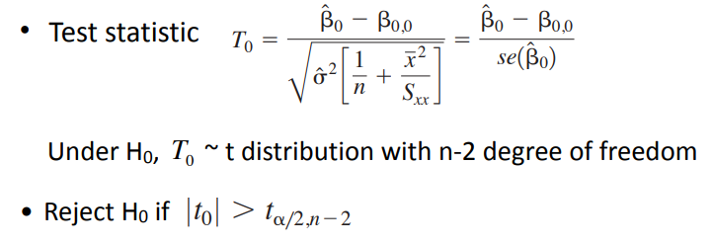
Use t-test for intercept
Use a similar form of test
H₀: β₀ = β_{0,0}
H₁: β₀ != β_{0,0}

Slide 41
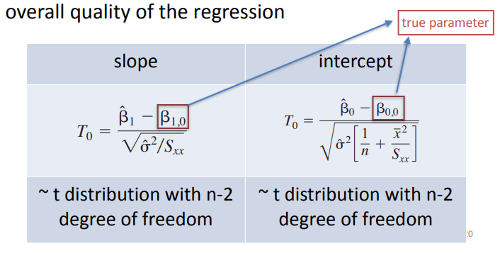
Confidence interval
we can obtain confidence interval estimates of slope and intercept
width of confidence interval is a measure of the

Slide 42
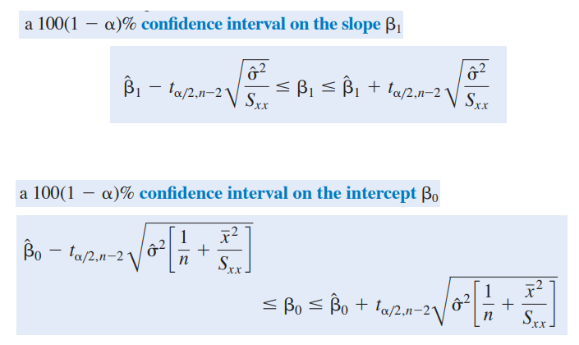
Confidence intervals

Slide 43
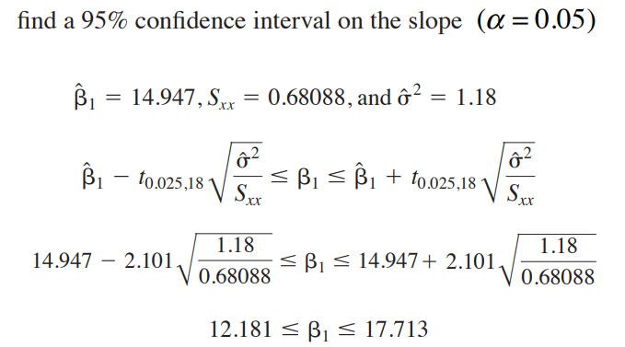
Example: oxygen purity tests of coefficients
The confidence interval does not include 0, so enough evidence saying there is enough correlation between X and Y.

Slide 44

Example: house selling price and annual taxes
Sale Price/1000 | Taxes (Local, School), County)/1000 | Sale Price/1000 | Taxes (Local, School), County)/1000
25.9 | 4.9176 | 30.0 | 5.0500
29.5 | 5.0208 | 36.9 | 8.2464
27.9 | 4.5429 | 41.9 | 6.6969
25.9 | 4.5573 | 40.5 | 7.7841
29.9 | 5.0597 | 43.9 | 9.0384
29.9 | 3.8910 | 37.5 | 5.9894
30.9 | 5.8980 | 37.9 | 7.5422
28.9 | 5.6039 | 44.5 | 8.7951
35.9 | 5.8282 | 37.9 | 6.0831
31.5 | 5.3003 | 38.9 | 8.3607
31.0 | 6.2712 | 36.9 | 8.1400
30.9 | 5.9592 | 45.8 | 9.1416
Independent variable X: SalePrice Dependent variable Y: Taxes

Slide 45
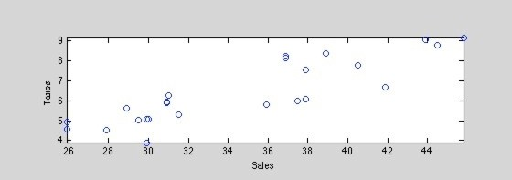

qualitative analysis
Calculate correlation
= 0.8760

Slide 46


Slide 47


Fitted simple linear regression model yˆ = −1.5837 + 0.2308x
n
∑
r
2
i
residuals: σˆ ² = MSE = ^{i=1}
= 0.6088
n − 2

Slide 48


standard error of regression coefficients
0.6088 _{= 0.0271}
829.0462
=
[
]
1 34.6125²
= 0.6088
+
= 0.9514
24 829.0462

Slide 49


test
Test H₀: β₁ = 0 using the t-test; use α = 0.005
calculate test statistics
threshold
^{t}α/2,n- 2
^{= t}0.0025,22 ^{= 3.119}
value of test statistic is greater than threshold
—> reject H0

Slide 50


Slide 51
Bias-Variance Decomposition and Bias-Variance Trade-oﬀ
(and how it related to overfitting and underfitting)

Slide 52

Overfitting and Underfitting
large
small
large

Slide 53
Bias-Variance Decomposition
Decomposition of the loss into bias and variance help us understand learning algorithms, concepts are related to underfitting and overfitting
Helps explain why ensemble methods might perform better than single models
Sebastian Raschka

Slide 54

Bias-Variance Intuition
Low Variance
(Precise)
High Variance
(Not Precise)
Low Bias
(Accurate)
High Bias
(Not Accurate)
Sebastian Raschka

Slide 55

Bias-Variance Intuition

Slide 56




Slide 57




Bias-Variance Intuition

Slide 58


Bias-Variance Intuition
linear regression models

Slide 59
Bias-Variance Intuition
linear regression models
High bias
(There are points where the bias is zero ... )

Slide 60


Bias-Variance Intuition
(here, an unpruned decision tree is fitted)
High Variance Why?

Slide 61


Bias-Variance Intuition
Suppose we have multiple training sets
High variance

Slide 62
Bias-Variance Intuition
What happens if we take the average?
Does this remind you of something?
High variance

Slide 63




Bias-Variance Intuition

Slide 64
Terminology
Point estimator θ̂ of some parameter
(could also be a function, e.g., the hypothesis is an estimator of some target function)

Slide 65
Terminology
Point estimator θ̂ of some parameter
(could also be a function, e.g., the hypothesis is an estimator of some target function)
Bias = E[θ]̂ − θ

Slide 66
Terminology
General Definition
Bias[θ]̂ = E[θ]̂ − θ
Var[θ]̂ = E[ θ^{2̂} ] − (E[θ ]̂ )²
Var[θ]̂ = E [(E[θ]̂ − θ)^{̂ 2}]

Slide 67

Terminology
Bias[θ]̂ = E[θ]̂ − θ
Var[θ]̂ = E [(E[θ]̂ − θ)^{̂ 2}]
Intuition
(we ignore noise in this lecture for simplicity)
Sebastian Raschka

Slide 68
Terminology
Bias[θ]̂ = E[θ]̂ − θ
Var[θ]̂ = E [(E[θ]̂ − θ)^{̂ 2} ]
Bias is the difference between the average estimator from different training samples and the true
Intuition
value.
(we ignore noise in this lecture for simplicity)
(The expectation is over the
training sets.)

Slide 69
Terminology
Bias[θ]̂ = E[θ]̂ − θ Bias is the difference between the average
estimator from different training samples and the true value.
(The expectation is over the training sets.)
Var [θ ]̂ = E [(E[θ]̂ − θ)^{̂ 2}]
The variance provides an estimate of how much the estimate varies as we vary the training data (e.g., by resampling).
Intuition
(we ignore noise in this
lecture for simplicity)

Slide 70
Bias-Variance Decomposition
Loss = Bias + Variance + Noise

Slide 71
Terminology
Bias[θ]̂ = E [θ]̂ − θ
Var[θ]̂ = E [(E[θ]̂ − θ)^{̂ 2}]
Intuition
(we ignore noise in this lecture for simplicity)

Slide 72
Bias-Variance Decomposition
Loss = Bias + Variance + Noise

Slide 73
Bias-Variance of the Squared Error
Bias[θ]̂ = E[θ]̂ − θ
"ML Notation" for
Var[θ]̂ = E[θ^{2̂} ] − (E[θ]̂ )²
Squared Error Loss
y = f(x) target
ŷ = f(̂ x) = h(x) prediction
S = (y − y)̂ ² squared error
Var[θ]̂ = E [(E[θ]̂ − θ)^{̂ 2}]
for simplicity, we ignore the noise term
(Next slides: the expectation is over the training data, i.e, the average estimator from diﬀerent training samples)

Slide 74
Bias-Variance of the Squared Error
y = f(x) target
"ML Notation" for
ŷ = f(̂ x) = h(x) prediction
S = (y − y)̂ ² squared error
Squared Error Loss
S = (y − y)̂ ²
(y − y)̂ ² = (y − E[y]̂ + E[y]̂ − y)̂ ²
= (y − E[y]̂ )² + (E[y]̂ − y)̂ ² − 2(y − E[y]̂ )(E[y]̂ − y)

Slide 75
Bias-Variance of the Squared Error
S = (y − y)̂ ²
(y − y)̂ ² = (y − E[y]̂ + E[y]̂ − y)̂ ²
???
= (y − E[y]̂ )² + (E[y]̂ − y)̂ ² − 2(y − E[y]̂ )(E[y]̂ − y)
E[2(y − E[y]̂ )(E[y]̂ − y)̂ ] = 2E[(y − E[y]̂ )(E[y]̂ − y)̂ ]
= 2(y − E[y]̂ )E[(E[y]̂ − y)̂ ]
= 2(y − E[y]̂ )(E[E[y]̂ ] − E[y]̂ )
= 2(y − E[y]̂ )(E[y]̂ − E[y]̂ )
= 0

Slide 76
Bias-Variance of the Squared Error
S = (y − y)̂ ²
(y − y)̂ ² = (y − E[y]̂ + E[y]̂ − y)̂ ²
= (y − E[y]̂ )² + (E[y]̂ − y)̂ ² + 2(y − E[y]̂ )(E[y]̂ − y)
E[S] = E [(y − y)̂ ²]
E [(y − y)̂ ²] = (y − E[y]̂ )² + E [(E[y]̂ − y)̂ ²]
= Bias² + Var

Slide 77
Bias-Variance of the Squared Error
S = (y − y)̂ ²
(y − y)̂ ² = (y − E[y]̂ + E[y]̂ − y)̂ ²
= (y − E[y]̂ )² + (E[y]̂ − y)̂ ²
E[S] = E [(y − y)̂ ²]
E [(y − y)̂ ²] = (y − E[y]̂ )² + E [(E[y]̂ − y)̂ ²]
= Bias² + Var
Bias[θ]̂ = E[θ]̂ − θ
Var[θ]̂ = E[θ^{2̂} ] − (E[θ]̂ )²
Var[θ]̂ = E [(E[θ]̂ − θ)^{̂ 2}]

Slide 78
Bias-Variance of the Squared Error
S = (y − y)̂ ²
(y − y)̂ ² = (y − E[y]̂ + E[y]̂ − y)̂ ²
???
= (y − E[y]̂ )² + (E[y]̂ − y)̂ ² − 2(y − E[y]̂ )(E[y]̂ − y)

Slide 79
Now, how is this related to overfitting and underfitting?

Slide 81


Slide 82
Thank you !

